Slide 1

Final Project
Telco Customer Churn Prediction
Linoy E., Roni S. and Shai F.
January 2022
Link to Notebook

Slide 2
Overview
Background
Dataset and Objective
EDA – Exploratory Data Analysis
Initial Analysis - using Pandas Profiling and LUX (Python API for Intelligent Visual Discovery)
Data Transformation
Feature Engineering
Clustering (Unsupervised Learning) - KMeans
Pre-Processing
Handling Data Imbalance – Using SMOTE
Classification Models – Traditional ML
Random Forest Classifier
XGBoost Classifier
Neural Network Models
Sequential Model
AutoKeras
Model Comparison
Discussion
Future Directions

Slide 3
Background
In today’s highly competitive telecom market, customers can choose from a variety of service providers, leave a service provider or switch to another service provider. The percentage of customers leaving a service is known as “churn”.
Companies try to retain their customers as long as possible, but in a competitive market, churn can be as high as 25% annually.
This is a problem for companies because acquiring a new customer can often cost 10 times more than retaining an existing one.
In order to be on top of this, companies ask themselves the following questions:
Who will churn? Are there specific user segments we are at risk of losing? (certain age groups?).
When will they churn? We need to predict churn probabilities for months in advance.
Why will they churn? We need to identify potential churn drivers and triggers (is it cost? quality? brand strength?).
What can we do to prevent this? (We need to provide different treatment options such as retention programs).

Slide 4
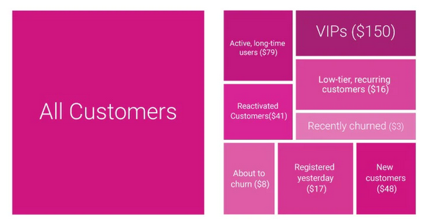
Example of how Companies Segment Customers

Slide 5
Dataset and Objective
The Telco customer churn data contains information about a fictional telecom company that provided home phone and Internet services to customers in California.
The data itself was taken from Kaggle: https://www.kaggle.com/blastchar/telco-customer-churn and is a subset of a larger dataset which originated from IBM Business Analytics Community.
The dataset contains 7,043 rows - each representing a single customer and 21 columns, with the “Churn” column being the target.
The data set includes information about:
Customer’s demographic information
Services in the customer’s contract and time with the company (“tenure”)
Customer’s contract and payment info (including “monthly charges”)
Customer “churn” (if customer left the company within the last month) – in the dataset ~27%.
Our Objective
Predict potential customer churn with purpose to develop customer retention programs.
This is a Binary Classification Problem

Slide 6
Columns
CustomerID (string) – A unique ID that identifies each customer (e.g., 7590-VHVEG)
Device Protection (Categorical) – whether the customer has device protection plan for their Internet equipment.
Tech Support (Categorical) – whether the customer subscribes to an additional technical support plan.
Streaming TV (Categorical) – whether the customer uses their Internet service to stream television (from 3rd party).
Streaming Movies (Categorical) – whether the customer uses their Internet to stream movies (from 3rd party).
Gender (categorical) – The customer’s gender: Male (50.5%) or Female (49.5%).
Partner (Boolean) – Indicates lives with a partner.
Senior Citizen (Boolean) – Indicates if the customer is 65 or older: Yes (16%), No (84%).
Dependents (Boolean) – Indicates if the customer lives with dependents (children, parents, grandparents).
Contract (Categorical) – the customer’s current contract type: Month-to-Month, One Year, Two Year.
Paperless Billing (Boolean) – whether the customer has chosen paperless billing.
Payment Method (Categorical) – Electronic check, Mailed check, Bank transfer (automatic), Credit card (automatic).
Monthly Charges (Numeric)– the customer’s current total monthly charge for all their services from the company.
Total Charges (String) – the customer’s total charges.
Tenure (Numeric) – the total number of months that the customer has been with the company.
Phone Service (Boolean) – whether the customer subscribes to home phone service with the company.
Multiple Lines (Boolean) – whether the customer subscribes to multiple telephone lines.
Internet Service (Categorical) – which Internet service the customer has: DSL, Fiber Optic, No Service.
Online Security (Categorical) – whether the customer subscribes to an additional online security service.
Online Backup (Categorical) – whether the customer subscribes to an additional online backup service.
Churn (Boolean) – Indicates if the customer left the company within the last month.

Slide 7
EDA
Initial Analysis:
No duplicates found.
“TotalCharges” column type is string (while “MonthlyCharges” is numeric).
Initially looks like there are no missing values…
Transformations and Fixes:
Converted “TotalCharges” column from “string” to “numeric”.
There are now 11 rows with “NaN” in the “TotalCharges” column.
Also found 11 rows in which “tenure” = 0.
These are the same 11 rows so we decided to drop them.
Numeric Values
Tenure – Mean: 32.37 months (~2 years 8 months), Min: 0, Max: 72 (6 years).
Monthly Charges – Mean: $64.76, Min: $18.25, Max: $118.75
Total Charges – Mean: $2,283. Min: $18.8, Max: $8,684.8

Slide 8
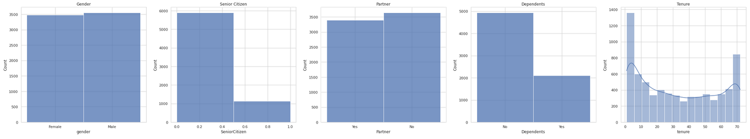
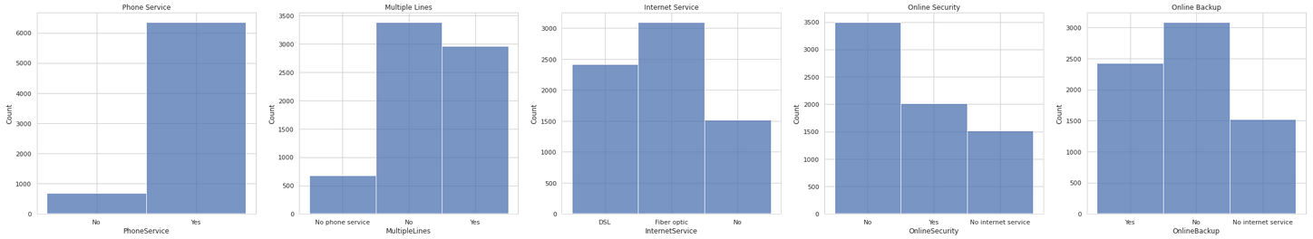
EDA
Gender
Senior Citizen
Partner
Dependents
Tenure (months)
Phone Service
Multiple Lines
Internet Service
Online Security
Online Backup

Slide 9
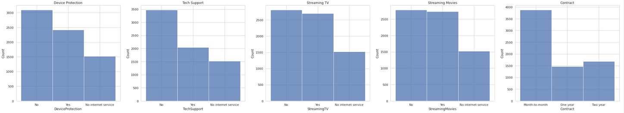
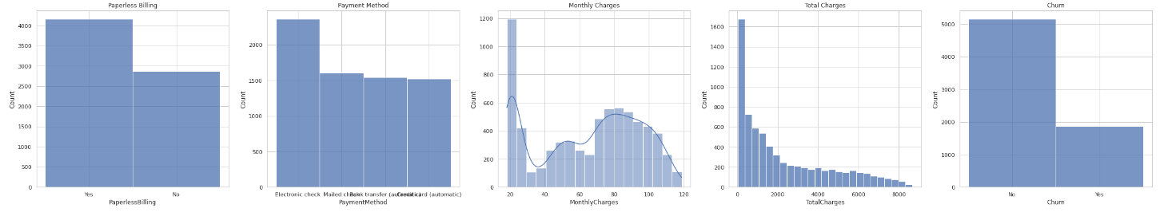
EDA
Target column (“Churn”) is imbalanced - Yes (26.5%), No (73.5%)
Device Protection
Tech Support
Streaming TV
Streaming Movies
Contract
Paperless Billing
Payment Method
Monthly Charges
Total Charges
Churn
73.5%
26.5%

Slide 10
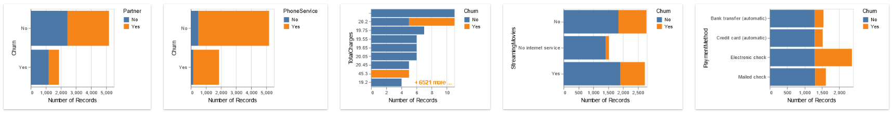
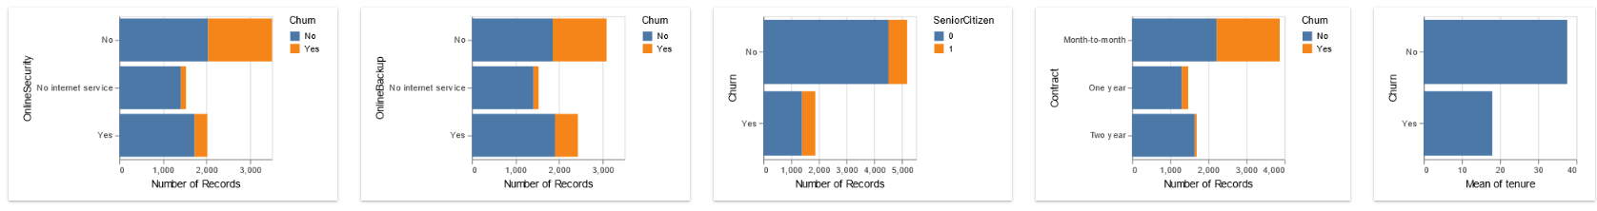
Customer Churn by Features (LUX)
LUX: A Python API for Intelligent Visual Discovery
https://github.com/lux-org/lux
https://lux-api.readthedocs.io/en/latest/

Slide 11
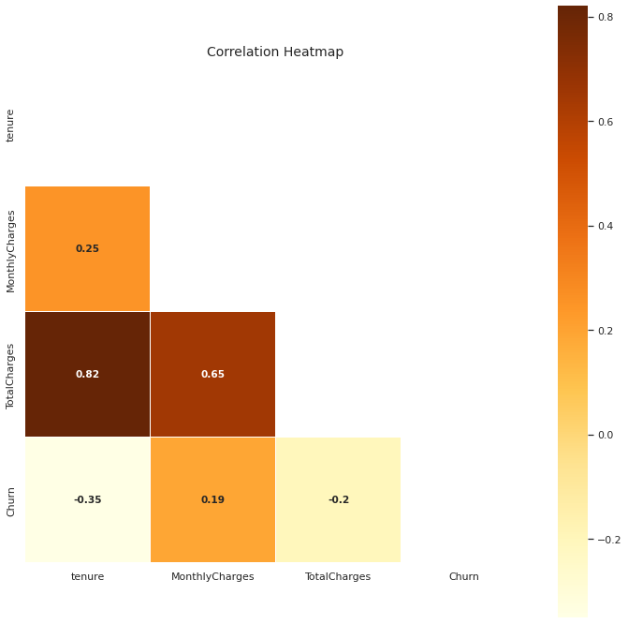
Correlation Matrix
Observable correlations between tenure and monthly charges and between tenure and total charges.
Observable correlation between tenure and churn (negative correlation)
Observable correlations between churn and monthly charges and between churn and total charges.

Slide 12
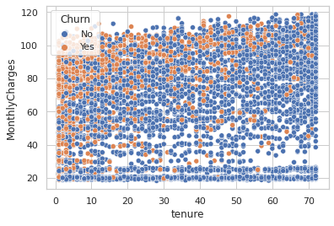
Customer Behavior / Monthly Charges and Tenure

Slide 13
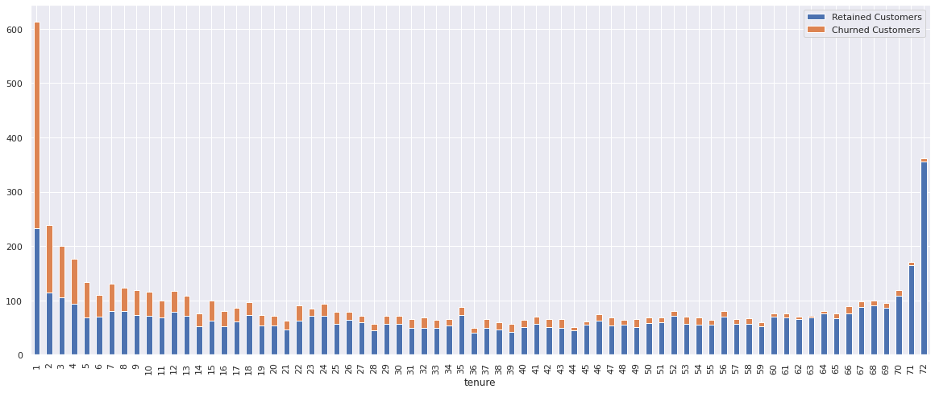
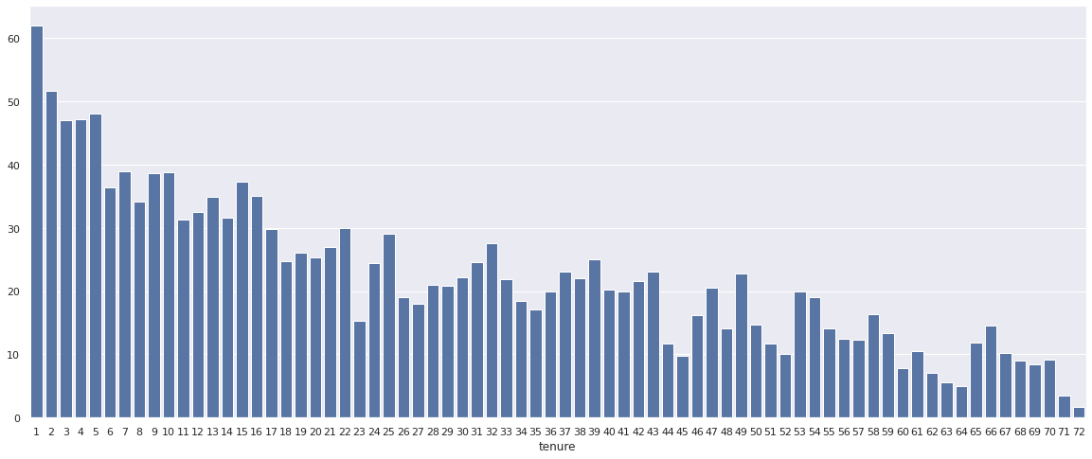
Customer Behavior by Tenure
Number of Retained and Churned Customers
Churn (Percentage)
We can see churn decreasing with time.

Slide 14
Feature Engineering

Slide 15
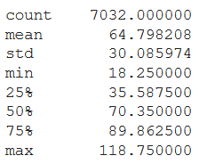
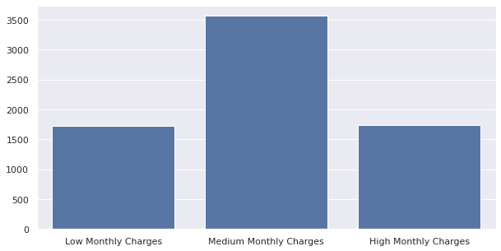
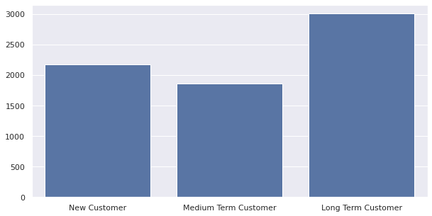
Feature Engineering - Binning Continuous Features
Binning Monthly Charges
Binning Tenure
New Feature: MonthlyChargesCategory
Low Monthly Charges <35
Medium Charges <90
High Charges >90
New Feature: TenureCategory
New Customer – first year
Medium term customer – 1 to 3 years
Medium term customer – over 3 years

Slide 16
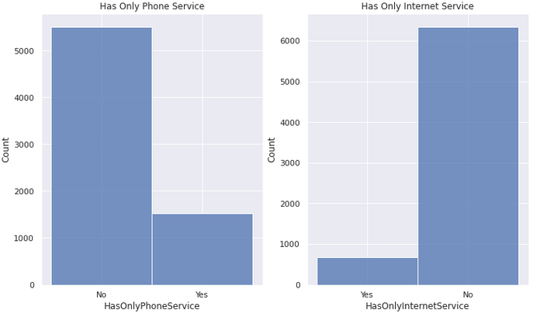
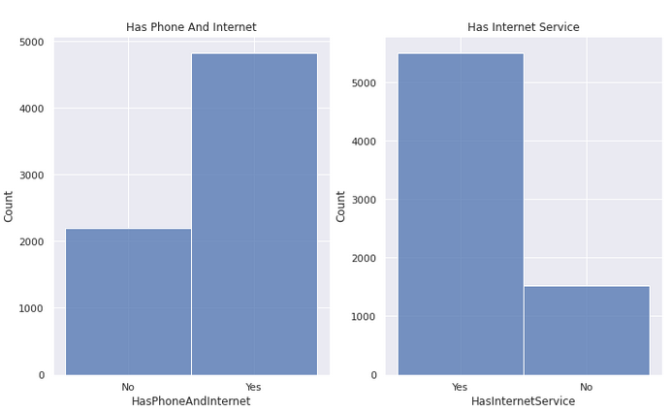
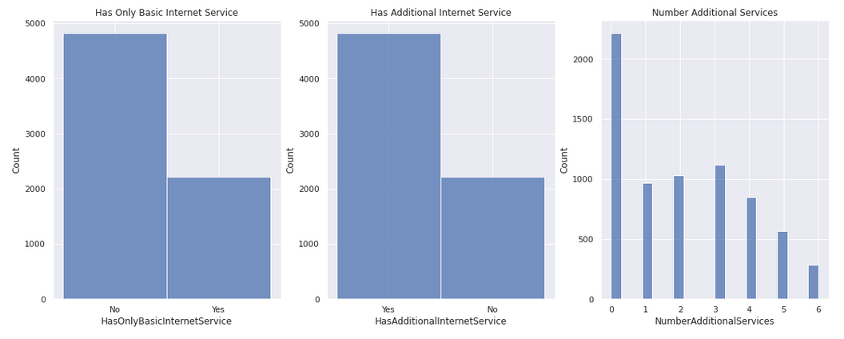
Feature Engineering - Adding New Features
Has Internet Service – can be either DSL or fiber
Has Only Phone Service - does not have Internet service
Has Only Internet Service - does not have phone service
Has both phone and Internet service
Has only basic Internet service - does not have one or more of the additional services (such as tech support, online backup, etc.)
Has additional Internet services - has at least one of the 6 additional services (such as tech support, online backup, streaming TV, etc.)
Number of Additional Services – number of Internet service a customer has (0-6)

Slide 17
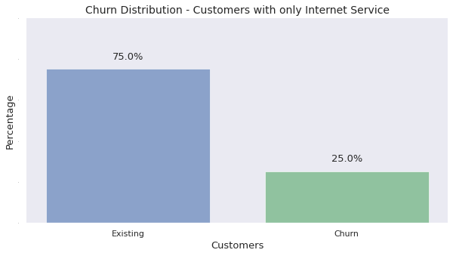
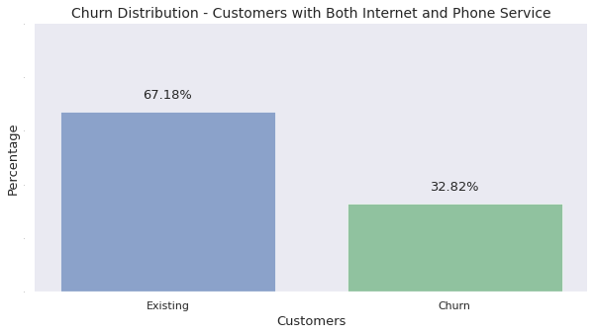
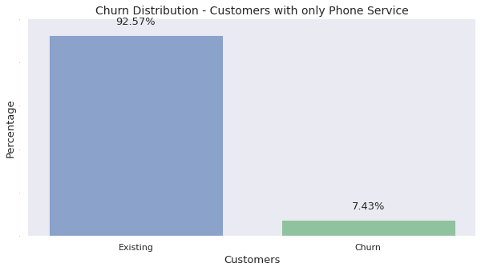
Analyzing New Features
Only Internet (No Phone)
Average Monthly Charges: $42
Both Internet and Phone
Average Monthly Charges: $82
Only Phone (No Internet)
Average Monthly Charges: $21
Analysis shows that churn is not a major issue for 1,520 customers who have only phone service and no Internet service. Also, the monthly charges of these customers is lower.
We should consider separating these and handling them as a separate problem.

Slide 18
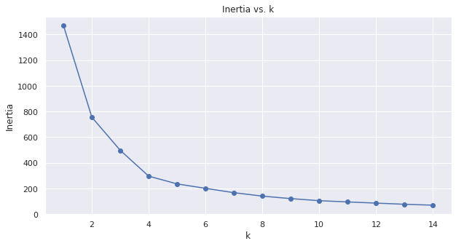
Clustering (KMeans) – Elbow Curve
Objective: Cluster customers into segments in order to analyze churn among the different customer profiles (and add the customer segment to the model features).
Clustering by tenure and monthly charges (numeric features)

Slide 19
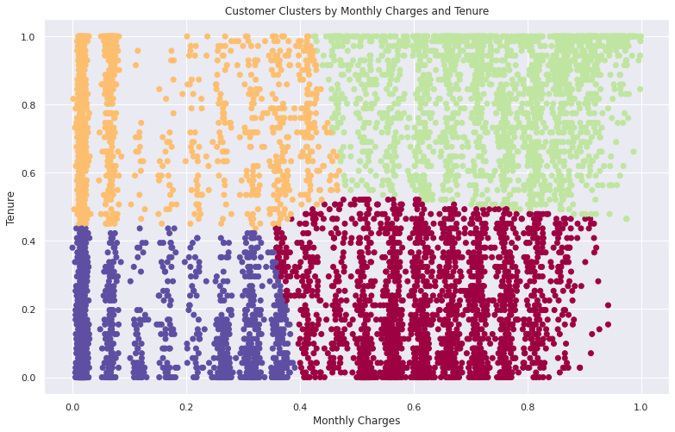
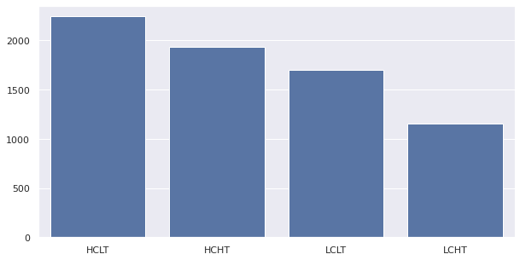
Clustering
Customer Segments
Low Charges High Tenure
High Charges High Tenure
2,243
1,934
1,702
1,153
HCLT
HCHT
LCLT
LCHT
Low Charges
Low Tenure
High Charges
Low Tenure
Q: Customers in which cluster are most likely to churn?

Slide 20
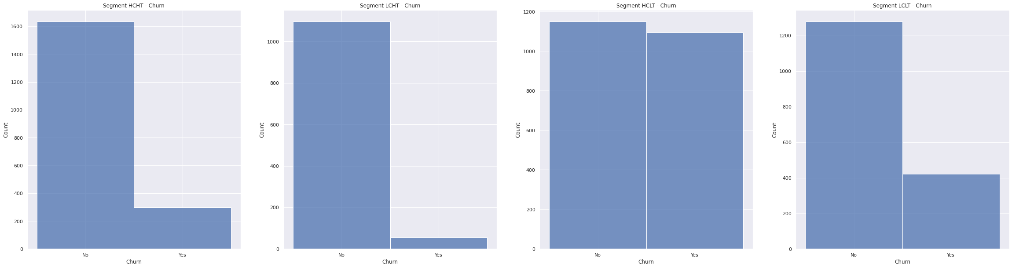
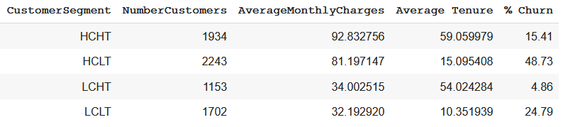
Clustering
Churn by Customer Cluster
HCHT
LCHT
HCLT
LCLT
85%
95%
51%
75%
49%
25%
15%
5%
New Feature: CustomerSegment (HCHT, HCLT, LCHT, LCLT)

Slide 21
Classification Models

Slide 22
Pre-processing
Started with 21 columns and added an additional 10 in feature engineering (total 31 columns).
Dropped ‘CustomerID’ (meaningless to the model).
Converted 'SeniorCitizen’ from 1/0 to Yes/No.
Converted 'Churn' target column from Yes/No to 1/0.
Applied one hot encoding (“drop first”) to al categorical columns (total 45 columns).
Split to X and y.
Split the data using train_test_split (75/25).
Scaled all numeric values using StandardScaler.

Slide 23
Handling Data Imbalance - SMOTE
Applied oversampling to the minority class (train set only) with goal to get an equal number of examples in the majority class (from 1,411 to 3,863). Technique used: SMOTE (Synthetic Minority Oversampling Technique) provided by the imbalanced-learn Python library in the SMOTE class.
Train set now has 7,727 rows (3,863 “0”s / 3,863 “1”s)
Original Train Set: 5,274 (75% of original dataset)
New Train Set: 7,726
https://machinelearningmastery.com/smote-oversampling-for-imbalanced-classification/

Slide 24
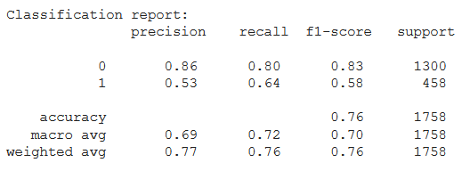
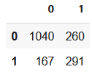
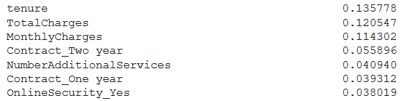
Random Forest Classifier (Grid Search : 5-fold Cross Validation)
rf_param_grid = {'n_estimators':[100, 500, 1000],
'max_depth':[4, 12, 16],
#'min_samples_leaf': [1, 2, 4],
'criterion':['gini','entropy']}
Best Parameters: {'criterion':'gini', 'max_depth': 16, 'n_estimators’: 1000}
Score | Metric
98% | Accuracy (train)
76% | Accuracy (test)
0.150 | RMSE (train)
0.492 | RMSE (test)
0.64 | Recall
0.53 | Precision
0.58 | f1
Confusion Matrix
Feature Importance

Slide 25
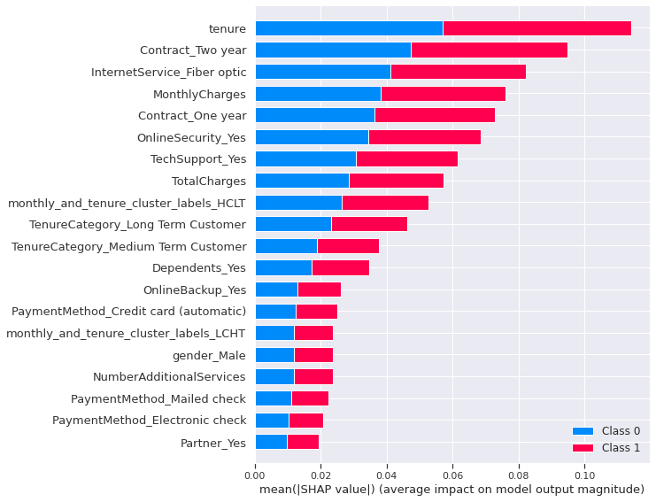
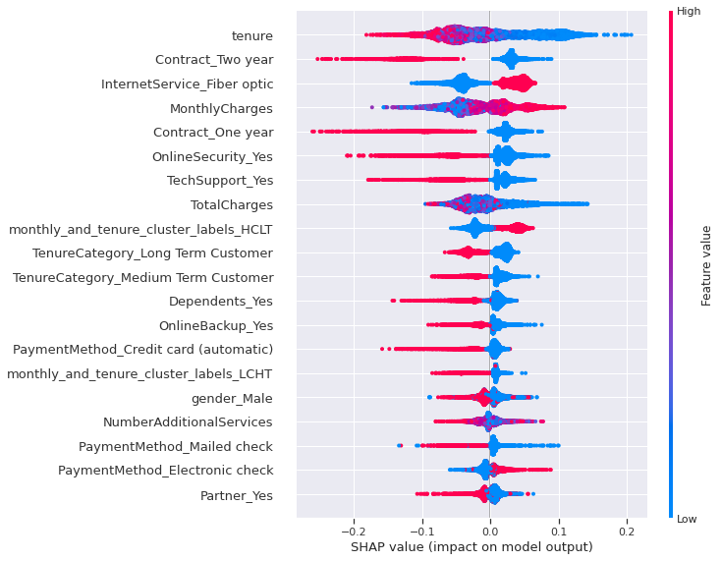
SHAP Values
SHAP (SHapley Additive exPlanations) is a unified approach to explain the output of any machine learning model. SHAP connects game theory with local explanations, uniting several previous methods and representing the only possible consistent and locally accurate additive feature attribution method based on expectations.
https://towardsdatascience.com/explain-your-model-with-the-shap-values-bc36aac4de3d

Slide 26
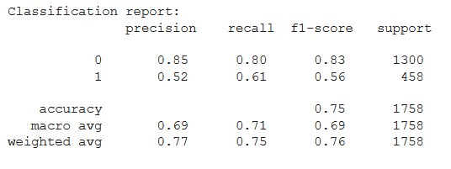
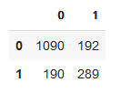
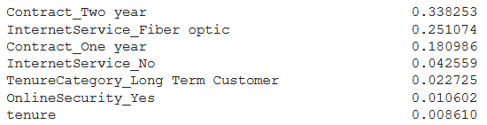
XGBoost Classifier (Grid Search : 5-fold Cross Validation)
xgb_param_grid = {'n_estimators': range(60,220,40),
'max_depth': range(2,10),
'learning_rate': [0.1, 0.01, 0.05]}
Best Parameters: {learning_rate’:0.05, 'max_depth’: 9, 'n_estimators’: 180}
Score | Metric
95% | Accuracy (train)
75% | Accuracy (test)
0.211 | RMSE (train)
0.498 | RMSE (test)
0.61 | Recall
0.52 | Precision
0.56 | f1
Confusion Matrix
Feature Importance

Slide 27
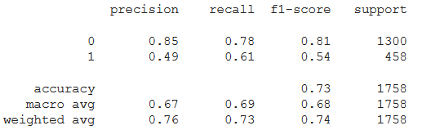
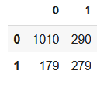
Neural Network - Keras
model = Sequential([
# input layer
Dense(44, input_shape=(44,), activation='relu'),
Dense(15, activation='relu'),
Dense(10,activation = 'relu'),
# output layer
Dense(1, activation='sigmoid')])
model.compile(optimizer = 'adam',
loss = 'binary_crossentropy',
metrics = ['accuracy'])
Score | Metric
89% | Accuracy (train)
73% | Accuracy (test)
 | RMSE (train)
 | RMSE (test)
0.61 | Recall
0.49 | Precision
0.54 | f1
Confusion Matrix

Slide 28
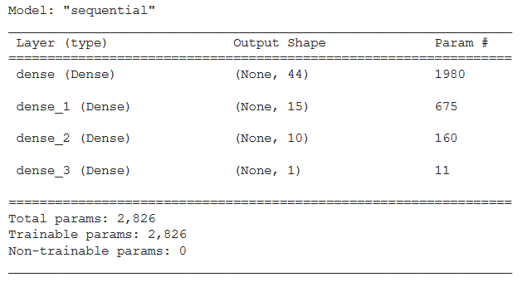
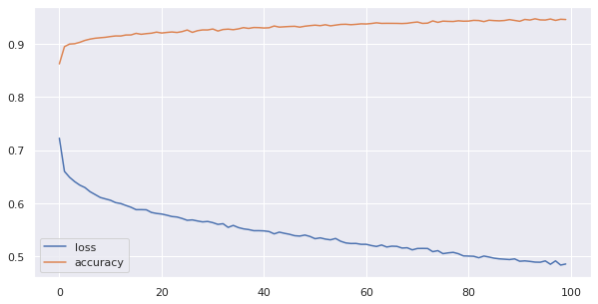
Neural Network - Model
Model Summary
History Plot

Slide 29
Model Comparison - Metrics
Neural Net | XGBoost | Random Forest | Metric
89% | 95% | 98% | Accuracy (train)
73% | 75% | 76% | Accuracy (test)
0.61 | 0.61 | 0.64 | Recall
0.49 | 0.52 | 0.53 | Precision
0.54 | 0.56 | 0.58 | f1
The random forest classification model gave us the best results on recall and f1 metrics .

Slide 30
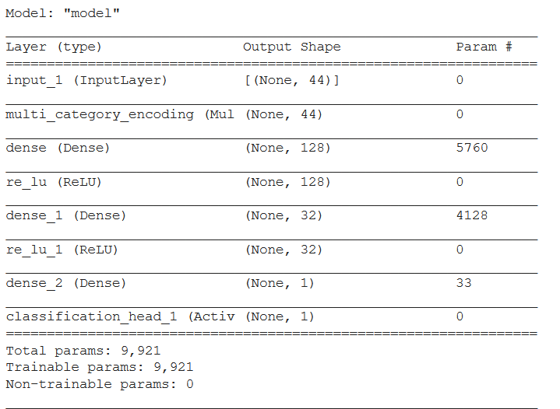
AutoKeras
import autokeras as ak
clf = ak.StructuredDataClassifier()
my_history = clf.fit(X_train, y_train)
model = clf.export_model()
model.summary()
clf.evaluate(X_test, y_test)
AutoKeras took long time to execute. Results were not as expected (no improvement).

Slide 31
Discussion
Accuracy
Useful for classification problems like this one. However, the real-life data will be imbalanced (we fixed this for the training set) and therefore may not be the best metric for choosing a model.
Recall
Telco will want to minimize false-negatives (falsely predicting actual churn) in order to not lose paying customers. So will want to maximize recall.
Precision
Telco will also want to minimize false-positives (falsely predicting customers as potential to churn) in order not to suggest costly retention plans to customers who do not need them.
Potential cost of losing customers is usually greater than the cost of a retention plan – so from a business perspective, recall is a more important metric. The f1 metric is also useful because it balances the recall and precision metrics. An f2 metric may be even better as it puts more weight to recall.

Slide 32
Future Directions
Target encoding vs. One Hot Encoding – check which method gets better results.
Use Isolation Forest to check for outliers.
Use SelectKBest or PCA for feature selection.
Split problem and run models separately for different segments and clusters.
Try additional models:
Logistic Regression
CatBoost
LGBM
Try modes with larger grid search, additional parameters, additional metrics (ROC/AUC) etc.
Further investigation of AutoKeras.

Slide 33
Thank You

